Slide 1
LESSON 27

Slide 2
Overview
of
Previous Lesson(s)

Slide 3
Over View
In syntax-directed translation 1st we construct a parse tree or a syntax tree then compute the values of attributes at the nodes of the tree by visiting the nodes of the tree.
Syntax-directed translations called L-attributed translations which encompass virtually all translations that can be performed during parsing.
S-attributed translations can be performed in connection with a bottom-up parse.
A syntax-directed definition (SDD) is a context-free grammar together with attributes and rules.

Slide 4
Over View..
A dependency graph depicts the flow of information among the attribute instances in a particular parse tree.
An edge from one attribute instance to another means that the value of the first is needed to compute the second.
Edges express constraints implied by the semantic rules.

Slide 5
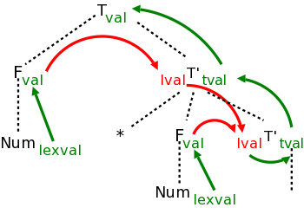
Over View…
The black dotted lines comprise the parse tree for the multiplication grammar just studied when applied to a single multiplication, e.g. 3*5.
Each synthesized attribute is shown in green and is written to the right of the grammar symbol at the node where it is defined.
Each inherited attribute is shown in red and is written to the left of the grammar symbol where it is defined.

Slide 6
Over View…
Each green arrow points to the synthesized attribute calculated from the attribute at the tail of the arrow.
These arrows either go up the tree one level or stay at a node.
That is because a synthesized attribute can depend only on the node where it is defined and that node's children.
The computation of the attribute is associated with the production at the node at its arrowhead.

Slide 7
Over View…
Each red arrow points to the inherited attribute calculated from the attribute at the tail.
The common attribute at the arrowheads, depends on both attributes at the tails.
According to the rules for inherited attributes, these arrows either go down the tree one level, go from a node to a sibling, or stay within a node.
The computation of the attribute is associated with the production at the parent of the node at the arrowhead.

Slide 8
Over View…
The dependency graph characterizes the possible orders in which we can evaluate the attributes at the various nodes of a parse tree.
If the dependency graph has an edge from node M to node N then the attribute corresponding to M must be evaluated before the attribute of N.
The only allowable orders of evaluation are those sequences of nodes N₁, N₂, … ,N_{k} such that if there is an edge of the dependency graph from N_{i} to N_{j} then i < j
Such an ordering embeds a directed graph into a linear order, and is called a topological sort of the graph.

Slide 9
Over View…
There are classes of SDDs for which a suitable evaluation order is guaranteed.
An SDD is S-attributed if every attribute is synthesized.
An SDD is called L-attributed definition if they allow the attributes to be evaluated in one left-to-right traversal of the abstract syntax tree. As a result, attribute evaluation in L-attributed grammars can be incorporated conveniently in top-down parsing.
Translation schemes involve side effects:
A desk calculator might print a result
A code generator might enter the type of an identifier into a symbol table

Slide 10
Over View…
Side effects in SDD's can be controlled by one of the following ways:
Permit incidental side effects that do not constrain attribute evaluation.
Constrain the allowable evaluation orders so that the same translation is produced for any allowable order.
The constraints can be thought of as implicit edges added to the dependency graph.

Slide 11
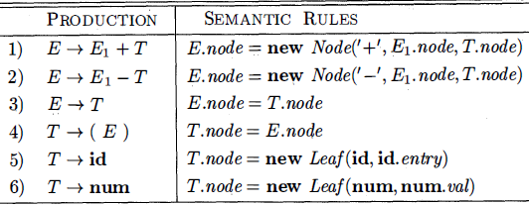
Over View…
This S-attributed definition constructs syntax trees for a simple expression grammar involving only the binary operators + and –
These operators are at the same precedence level & are jointly left associative.
All non-terminals have one synthesized attribute node, which represents a node of the syntax tree.
Every time the first production E → E₁ + T is used, its rule creates a node with ' + ' for op and two children, E₁ node and T node, for the sub-expressions.

Slide 12
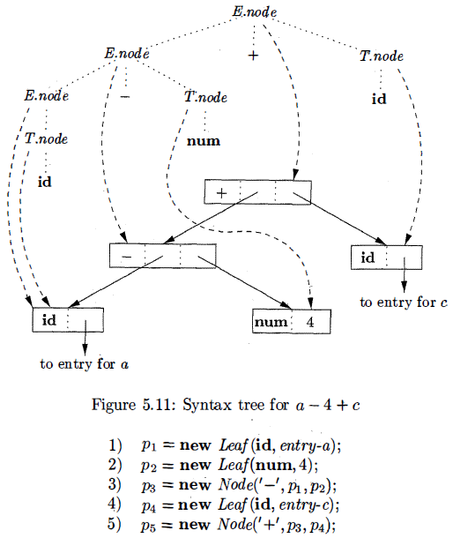
Over View…
Steps in the construction of the syntax tree for a - 4 + c

Slide 13
Contents
Applications of Syntax-Directed Translation
Construction of Syntax Trees
The Structure of a Type
Syntax-Directed Translation Schemes
Postfix Translation Schemes
Parser-Stack Implementation of Postfix SDT's
SDT's With Actions Inside Productions
Eliminating Left Recursion From SDT's
SDT's for L-Attributed Definitions

Slide 14
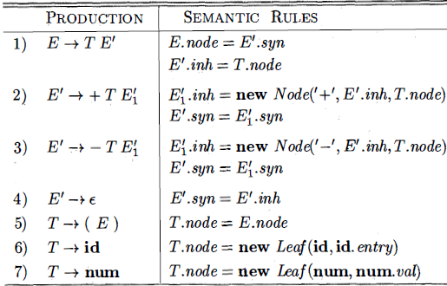
Construction of Syntax Trees…
The L-attributed definition which performs the same translation.
The attributes for the grammar symbols E, T, id, and num have the same desc.

Slide 15
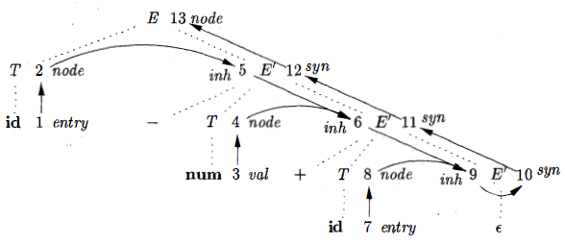
Construction of Syntax Trees…
Dependency graph for a - 4 + C

Slide 16
The Structure of a Type
Inherited attributes are useful when the structure of the parse tree differs from the abstract syntax of the input.
Attributes can then be used to carry information from one part of the parse tree to another.
Lets see an example which shows how a mismatch in structure can be due to the design of the language, and not due to constraints imposed by the parsing method.

Slide 17
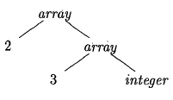
The Structure of a Type..
Ex. In C, the type int[2][3] can be read as, array of 2 arrays of 3 integers
Type expression for int[2][3]
The operator array takes two parameters, a number and a type.
If types are represented by trees, then this operator returns a tree node labeled array with two children for a number and a type.

Slide 18
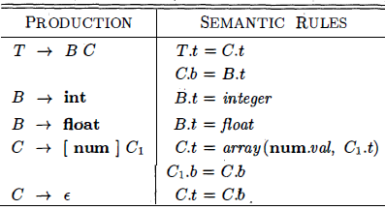
The Structure of a Type…
With this SDD non-terminal T generates either a basic type or an array type.
Non-terminal B generates one of the basic types int and float
T generates a basic type when T derives B C and C derives ɛ
Otherwise C generates array components consisting of a sequence of integers, each integer surrounded by brackets.

Slide 19
The Structure of a Type…
The non-terminals B and T have a synthesized attribute t representing a type.
The non-terminal C has two attributes:
An inherited attribute b
A synthesized attribute t.
The inherited b attributes pass a basic type down the tree, and the synthesized t attributes accumulate the result.

Slide 20
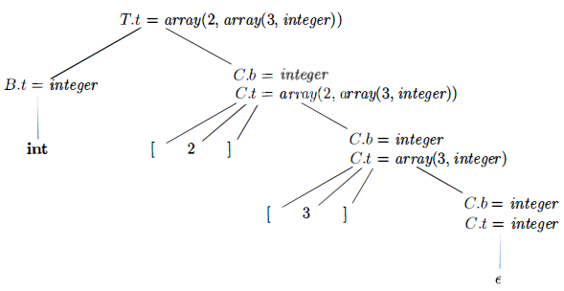
The Structure of a Type…
An annotated parse tree for the input string int[2][3]
The array type is synthesized up the chain of C's through the attributes t
At the root for T → B C non-terminal C inherits the type from B using the inherited attribute C.b
At the rightmost node for C the production is C → ɛ so C.t equals C.b
The semantic rules for the production C → [num] C₁ form C.t by applying the operator array to the operands num.val and C₁.t

Slide 21
SD Translation Schemes
A syntax-directed translation scheme (SDT) is a context free grammar with program fragments embedded within production bodies.
The program fragments are called semantic actions and can appear at any position within a production body.
Any SDT can be implemented by first building a parse tree and then performing the actions in a left-to-right depth-first order, that is, during a preorder traversal.

Slide 22
SD Translation Schemes..
SDT is used to implement two important classes of SDD's:
The underlying grammar is LR-parsable, and the SDD is S-attributed
The underlying grammar is LL-parsable, and the SDD is L-attributed
SDT's that can be implemented during parsing can be characterized by introducing distinct marker non-terminals in place of each embedded action.
Each marker M has only one production, M → ɛ
If the grammar with marker non-terminals can be parsed by a given method, then the SDT can be implemented during parsing.

Slide 23
Postfix Translation Schemes
The simplest SDD implementation occurs when we can parse the grammar bottom-up and the SDD is S-attributed.
For this, we can construct an SDT in which each action is placed at the end of the production and is executed along with the reduction of the body to the head of that production.
SDT's with all actions at the right ends of the production bodies are called postfix SDT's.

Slide 24
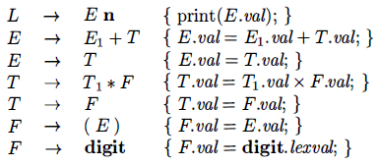
Postfix Translation Schemes..
Postfix SDT implementing the desk calculator

Slide 25
Parser-Stack Implementation of Postfix SDT's
Postfix SDT's can be implemented during LR parsing by executing the actions when reductions occur.
The attribute(s) of each grammar symbol can be put on the stack in a place where they can be found during the reduction.
The best plan is to place the attributes along with the grammar symbols (or the LR states that represent these symbols) in records on the stack itself.

Slide 26
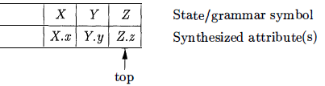
Parser-Stack Implementation of Postfix SDT's..
The parser stack contains records with a field for a grammar symbol & a field for an attribute.
If the attributes are all synthesized, and the actions occur at the ends of the productions, then we can compute the attributes for the head when we reduce the body to the head.
If we reduce by a production such as A → X Y Z, then we have all the attributes of X, Y, and Z available, at known positions on the stack
After the action, A and its attributes are at the top of the stack, in the position of the record for X .

Slide 27
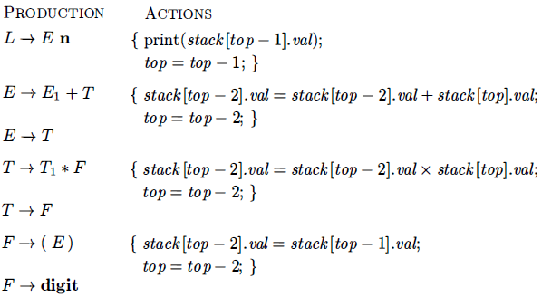
Parser-Stack Implementation of Postfix SDT's…
Actions for Implementing the desk calculator on a bottom-up parsing stack.
The stack is kept in an array of records called stack, with top a cursor to the top of the stack.
stack[top] refers to the top record on the stack, stack[top - 1] to the record below that, and so on.
Each record has a field called val which holds the attribute of whatever grammar symbol is represented in that record.

Slide 28
SDT's With Actions Inside Productions
An action may be placed at any position within the body of a production. It is performed immediately after all symbols to its left are processed.
So, For a production B → X {a} Y the action a is done after we have recognized X (if X is a terminal) or all the terminals derived from X (if X is a non-terminal).
Ex: Turn desk-calculator into an SDT that prints the prefix form of an expression, rather than evaluating the expression.

Slide 29
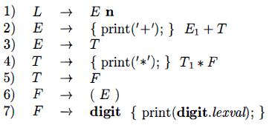
SDT's With Actions Inside Productions..
SDT for infix-to-prefix translation during parsing
it is impossible to implement this SDT during either top-down or bottom-up parsing.
The parser would have to perform critical actions, like printing instances of * or +, long before it knows whether these symbols will appear in its input.

Slide 30
SDT's With Actions Inside Productions…
Any SDT can be implemented as follows:
Ignoring the actions, parse the input and produce a parse tree as a result.
Then, examine each interior node N, say one for production B → α Add additional children to N for the actions in α so the children of N from left to right have exactly the symbols and actions of α
Perform a preorder traversal of the tree, and as soon as a node labeled by an action is visited, perform that action.

Slide 31
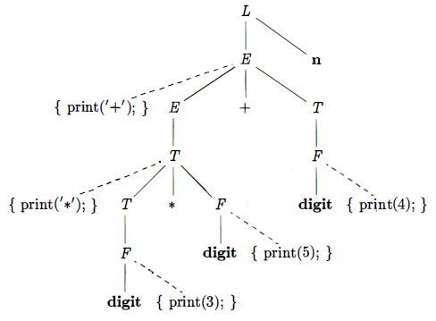
SDT's With Actions Inside Productions…
It shows the parse tree for expression 3 * 5 + 4 with actions inserted.
Visiting the nodes in preorder, we get the prefix form of the expression: + * 3 5 4.

Slide 32
Eliminating Left Recursion From SDT's
No grammar with left recursion can be parsed deterministically top-down.
When the grammar is part of an SDT, actions associated with them would also be take cared.
The first thing which we should take care is the order in which the actions in an SDT are performed.
When transforming the grammar, treat the actions as if they were terminal symbols.
This principle is based on the idea that the grammar transformation preserves the order of the terminals in the generated string.

Slide 33
Eliminating Left Recursion From SDT's..
The actions are executed in the same order in any left-to-right parse, top-down or bottom-up.
The "trick" for eliminating left recursion is to take two productions A → A α | β
It generate strings consisting of a β and any number of α‘s & replace them by productions that generate the same strings using a new non-terminal R of the first production:
A → β R
R → α β | ɛ
If β does not begin with A, then A no longer has a left-recursive production.
In regular-definition, with both sets of productions, A is defined by β(α)*

Slide 34
Eliminating Left Recursion From SDT's..
Ex. Following E-productions from an SDT for translating infix expressions into postfix notation:
E → E₁ + T { print (‘+’); }
E → T
If we apply the standard transformation to E, the remainder of the left-recursive production is
α = + T { print (‘+’); }
and β the body of the other production is T. If we introduce R for the remainder of E, we got: E → T R R → + T { print (‘+’); } R R → ɛ

Slide 35
Thank You

